Slide 1
Welcome!
To the active membership information session about our
23 committees!

Slide 2
Committees in general
Committees organize +/- 150 activities every year
Responsible for every aspect of the activity
Formal, informal, trips, support
Workload per week differs per committee
Practical experience
Cooperate
Meet new people

Slide 3
Different roles
Chairman
Treasurer
Marketing Officer
Internal
External

Slide 4
Committees that start in September
Big Data Day Committee
Career Committee
Community Committee
Connect Committee
Formal Master Committee
Informal Committee
Informal Master Committee
Magazine Committee
Member Deal Committee
NCE Committee
Party Committee
Personal Development Committee
PR Committee
Sport Committee
Synergy Drink committee
Synergy Weekend

Slide 5
Big Data Day Committee
Organises the Big Data Day
Formal activity in Business Analytics and Big Data
6-8 committee members
2-6 hours a week

Slide 6
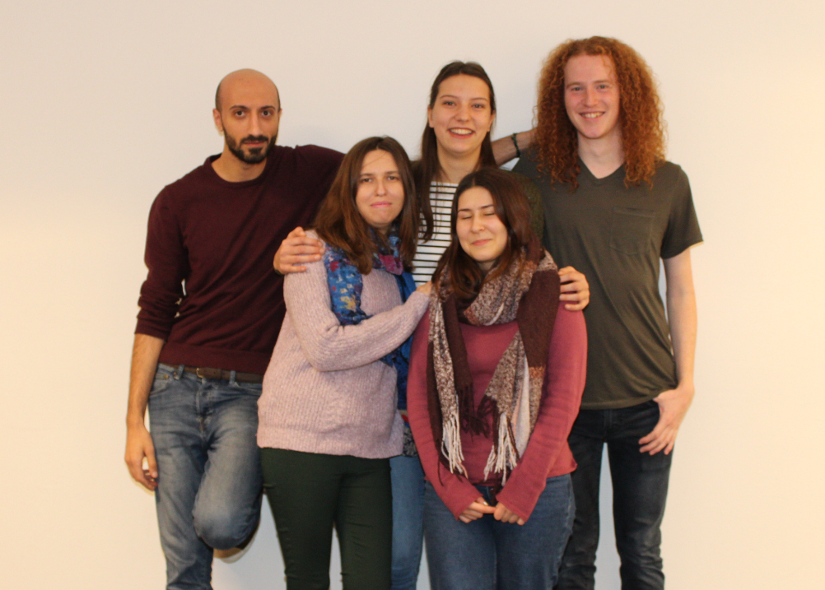
Community Committee
Do something for society
Community day: choose a charity group, fundraising campaign for Serious Request, RAGweek
5 committee members
Time spend: 0-2 hours a week

Slide 7
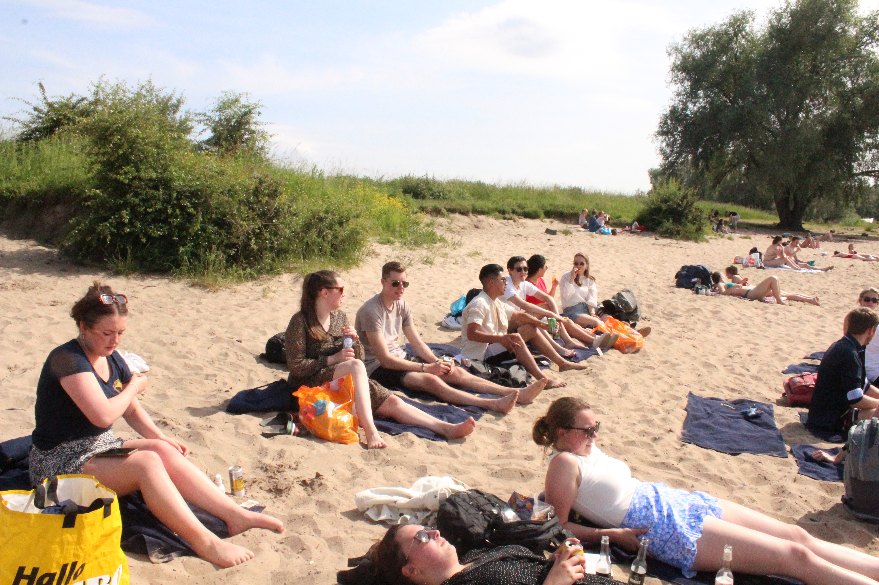
Connect Committee
Activities for specific students per study phase
Nice committee to start with
10 committee members
Time spent: 1 hour per week

Slide 8
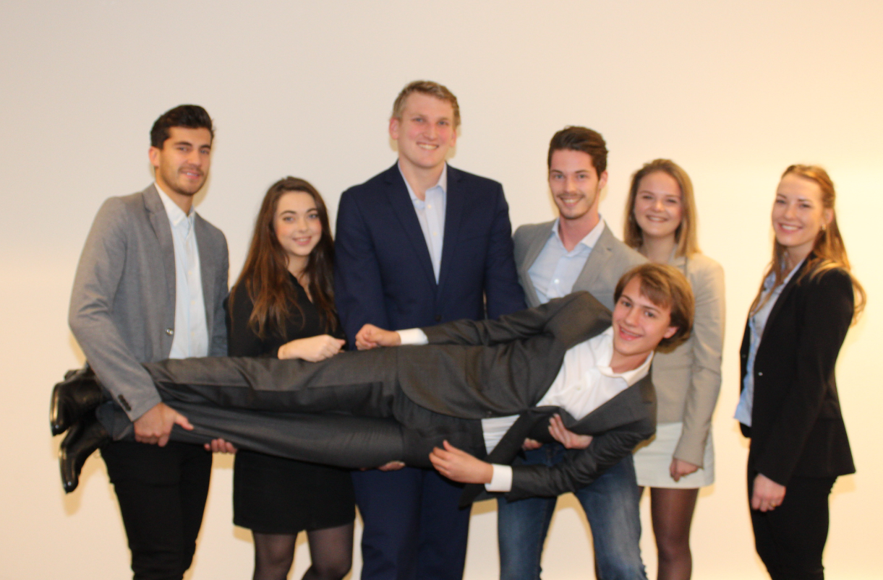
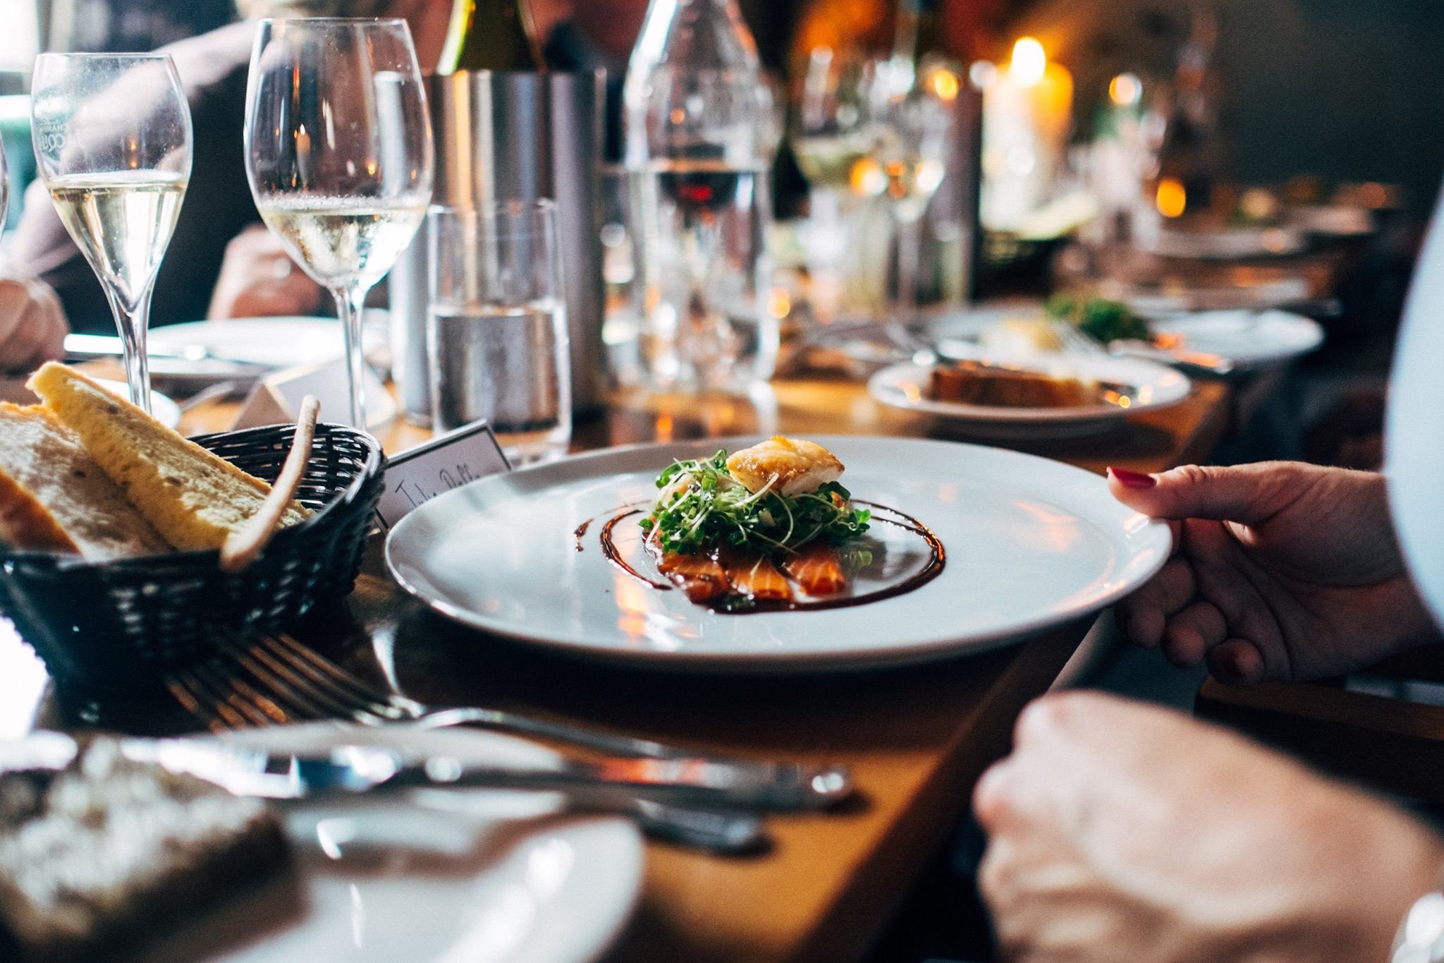
Formal Master Committee
Expand your network by contacting potential future employers
2 recruitment dinners
Formal activities
7 committee members
2 hours a week

Slide 9
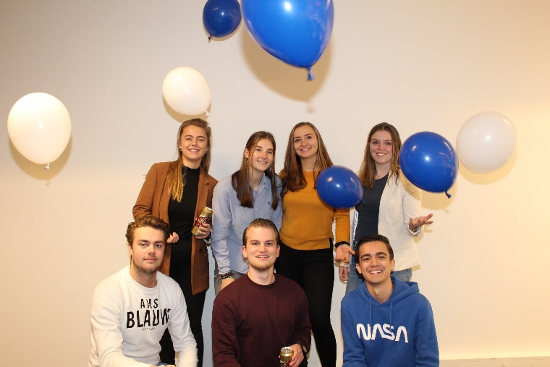
Informal Committee
Informal activities for fun
5 activities
1-2 hours a week
6-8 committee members

Slide 10
Informal Master Committee
Informal activities for Master students
5 activities
1-2 hours a week
6 committee members

Slide 11
Magazine Committee
Flexibility
Writing for Synergy & companies
Broad topics for a broad study
Write anywhere, anytime
5 committee members
2-3 hours a week

Slide 12
Member Deal Committee
Establish new member deals
Contact companies
Examples of member deals
3-4 committee members
1 hour a week

Slide 13
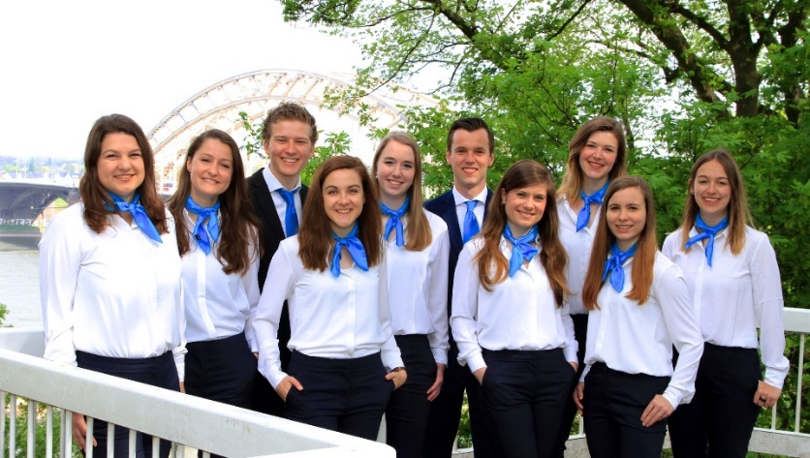
Nijmegen Career Event (NCE) Committee
Organizes the Nijmegen Career Event A two- day event where students and companies can meet each other in both formal- and informal settings
10 committee members:
3 – 10 hours per week
Collaboration between Synergy and the ESV

Slide 14
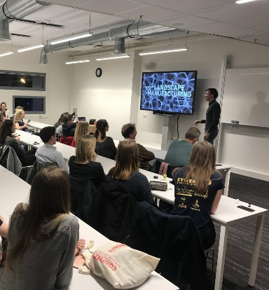
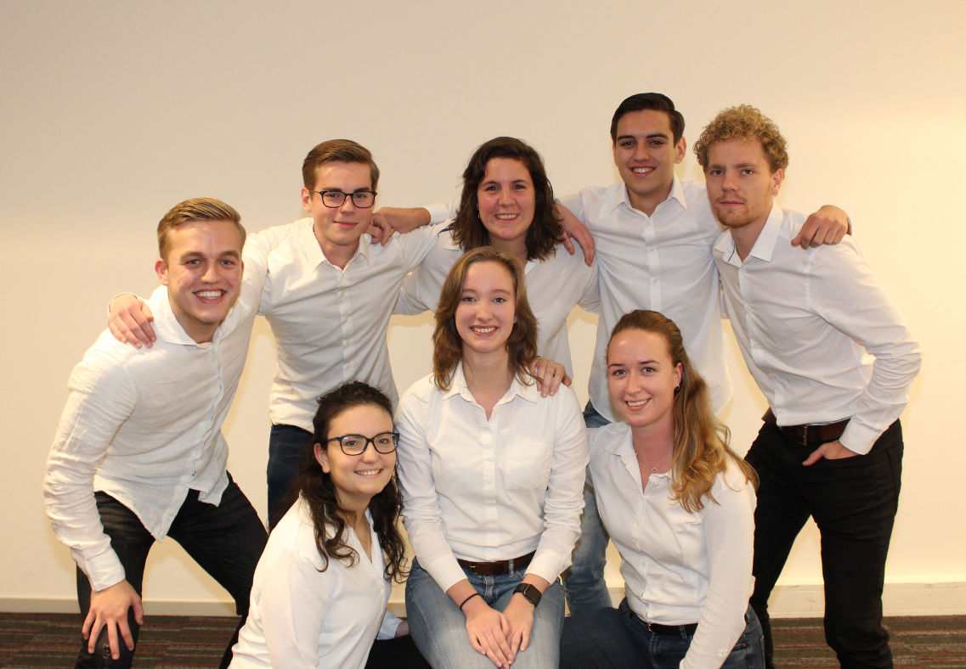
Career Committee
Formal activities
Inhouse days, workshops, readings and a business day
10 committee members
Time spent: average 3 hours per week

Slide 15
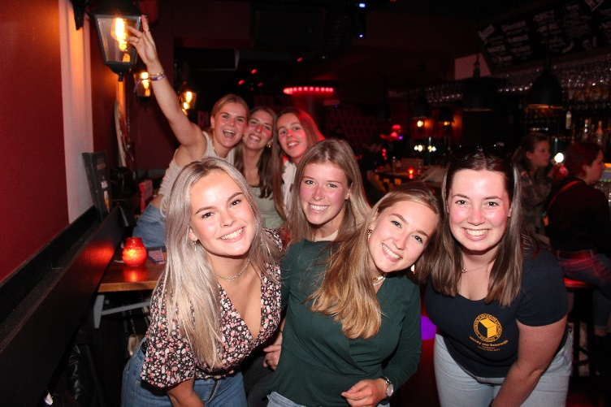
Party Committee
Organises all sorts of parties: - Open BA Party - BeRe Party - Management Madness
Often uses themes
8 committee members
1-2 hours a week

Slide 16
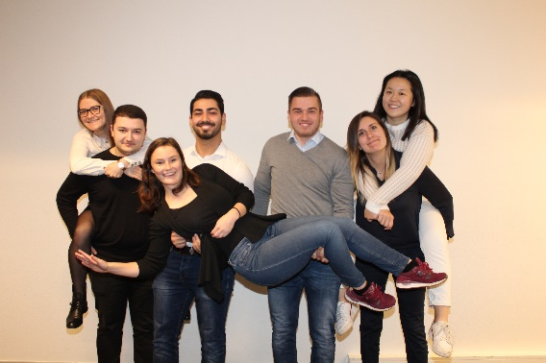
Personal Development Committee
Develop your own practical skills and talent
Not necessarily within a professional context
Focus on finding interesting opportunities for workshops, speakers etc.
7 committee members
1-2 hours a week

Slide 17
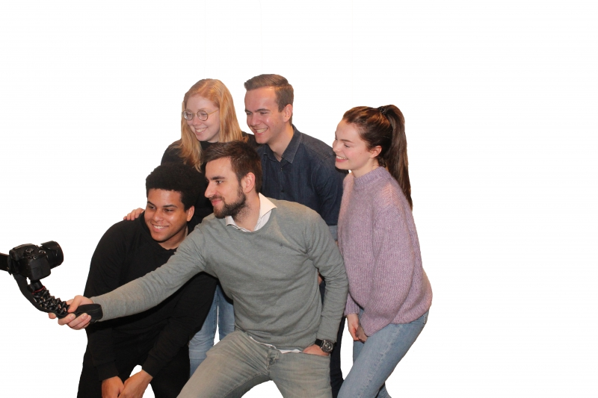
Photo Committee
Making pictures & filming during
Synergy activities & making them
‘website ready’
4 committee members (more members possible)
1 to 2 hours a week

Slide 18
PR Committee
Knowledge of Adobe is not necessary, there will be a workshop
Motivated to learn
Video editing
10 committee members
Average time spend depends on the requests

Slide 19
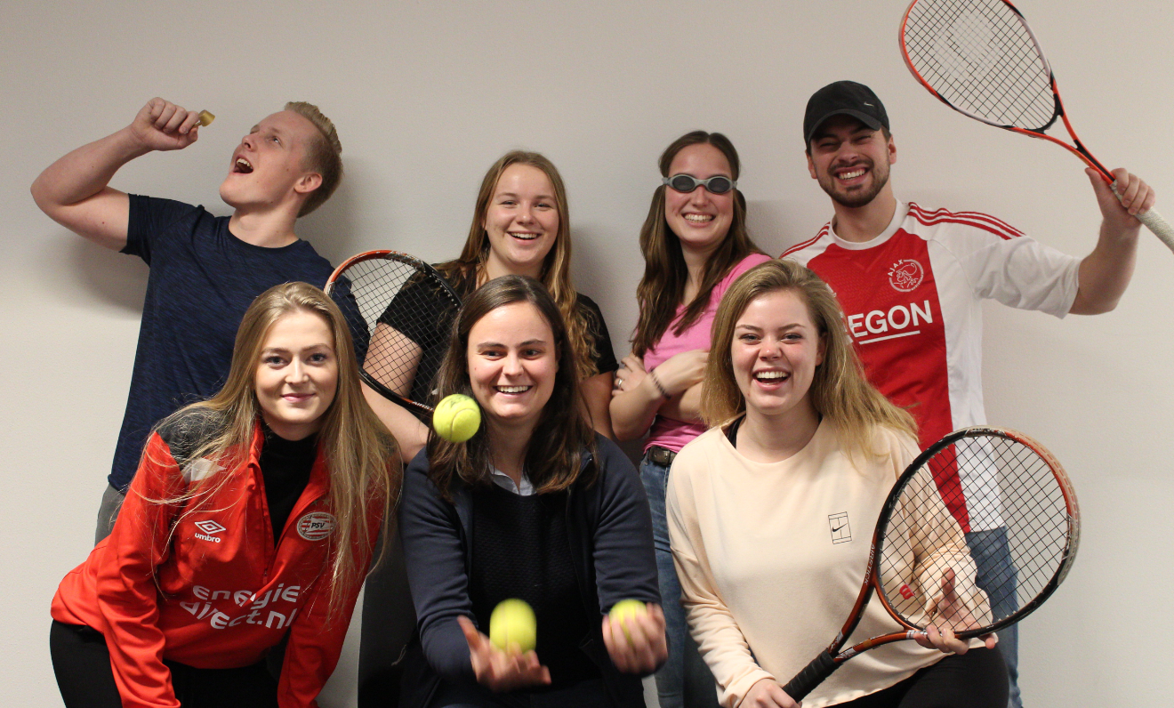
Sports Committee
7 committee members
1-2 hours a week
2 Free activities
2 Fixed activities
Batavierenrace
Soccer Tournament

Slide 20
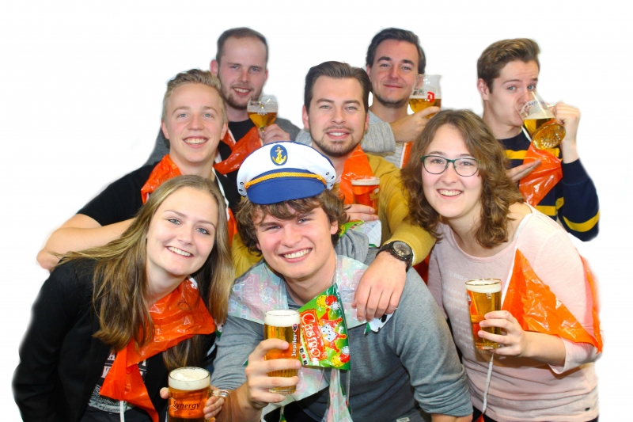
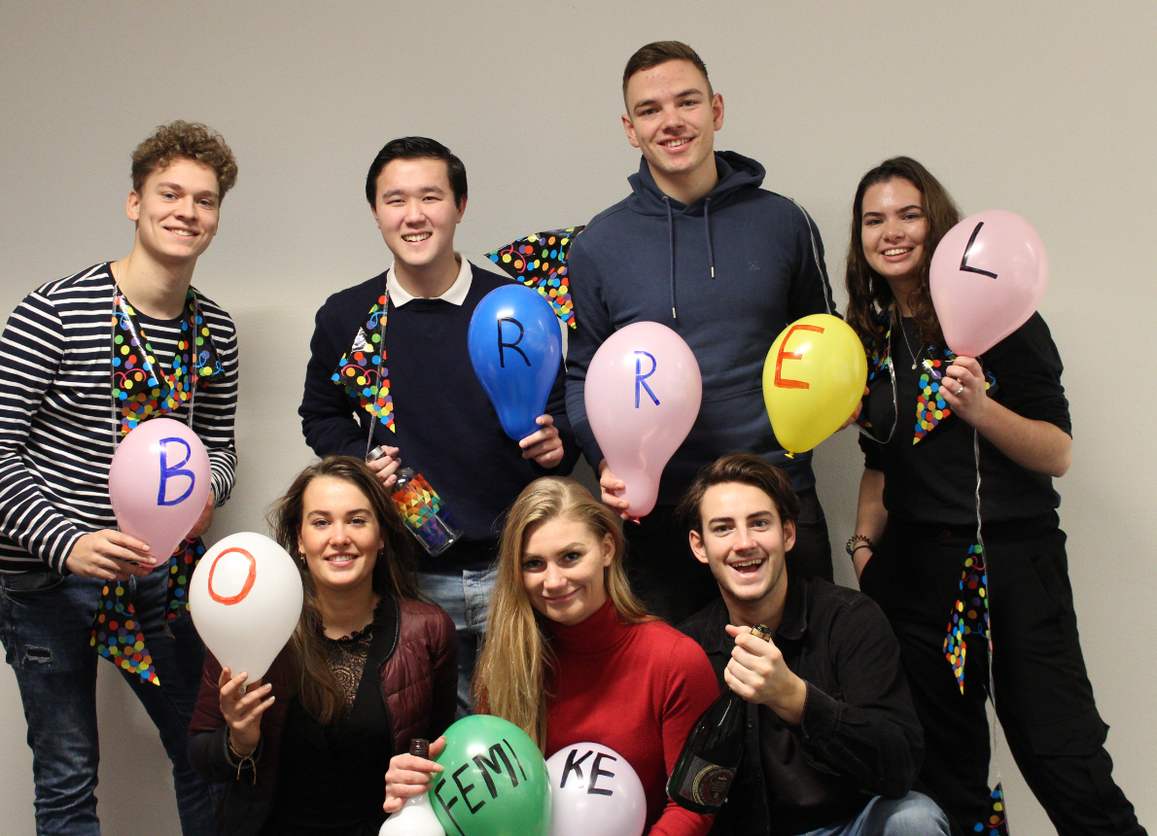
Synergy Drink
What do you organize?
Monthly Synergy Drink
After Exam Lunches/Drinks
Synergy Division
8 committee members
1 or 2 hours per week

Slide 21
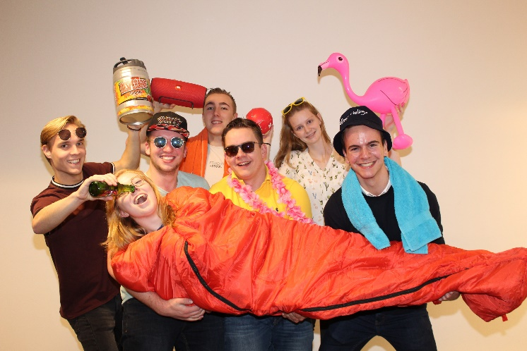
Synergy Weekend
Organizing member weekend
The committee organizes - Activities - Transportation - Food
7 committee members
1-3 hours a week

Slide 22
Committees that start in February
Atlas Committee
Business Trip Committee
Orientation Week Committee
Kick-off Committee
Ski Trip Committee
Synergy Week Committee

Slide 23
Atlas Committee
Yearly business trip for 40 people, 7/8 days (April/May)
Company visits, cultural activities, clubbing in a foreign city!
6 committee members
1-4 hours a week, differs per period

Slide 24
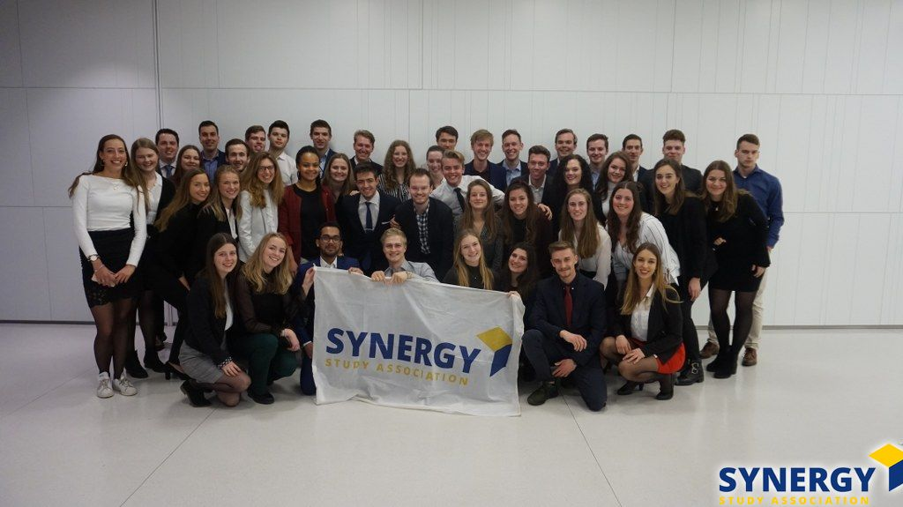
Business Trip Committee
Organizing a business trip to an European city
8 committee members
2 hours a week

Slide 25
Kick Off Committee
7 committee members
13 activities (formal and informal) in October and September.
2 to 3 hours/week

Slide 26
Orientation Week Committee
New students
Orientation week
Orientation battle
Free activity
Three parties
7 committee members
1 hour a week

Slide 27
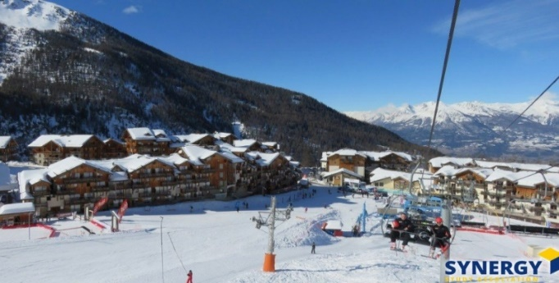
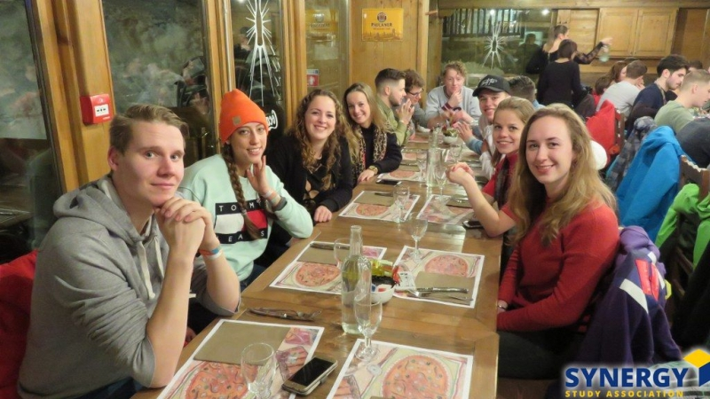
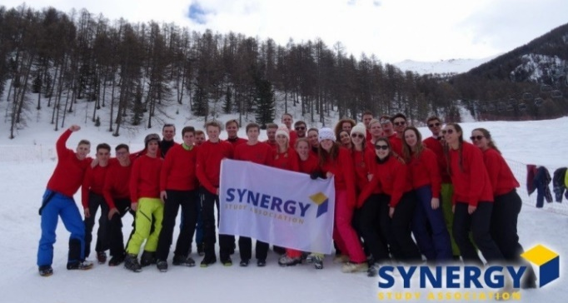
Ski Trip Committee
Organizing a ski trip for 40 people
6 committee members
What do you do: - Location - Evening activities - Introduction activity - Final drink
2 hours a week

Slide 28
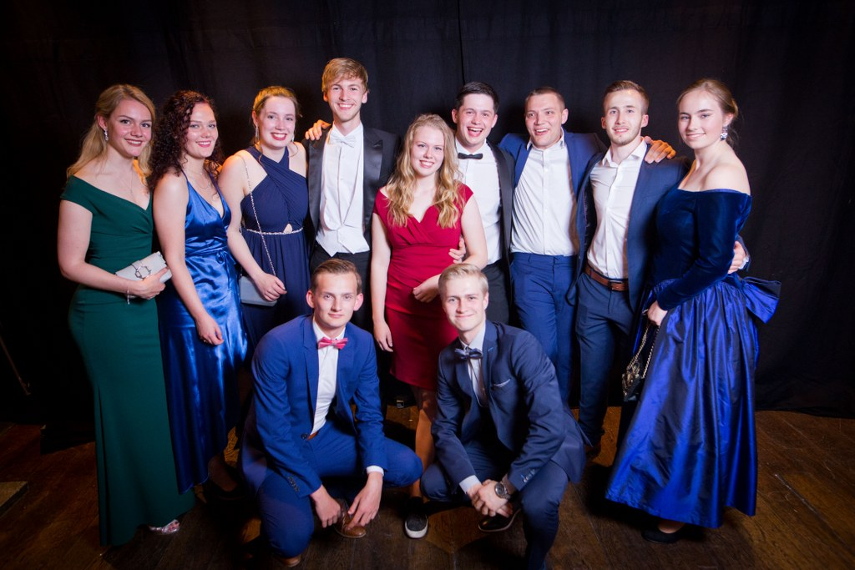
Synergy Week Committee
A week in May full of activities
Formal and Informal activities
Synergy Gala
9 committee members
3 hours a week

Slide 29
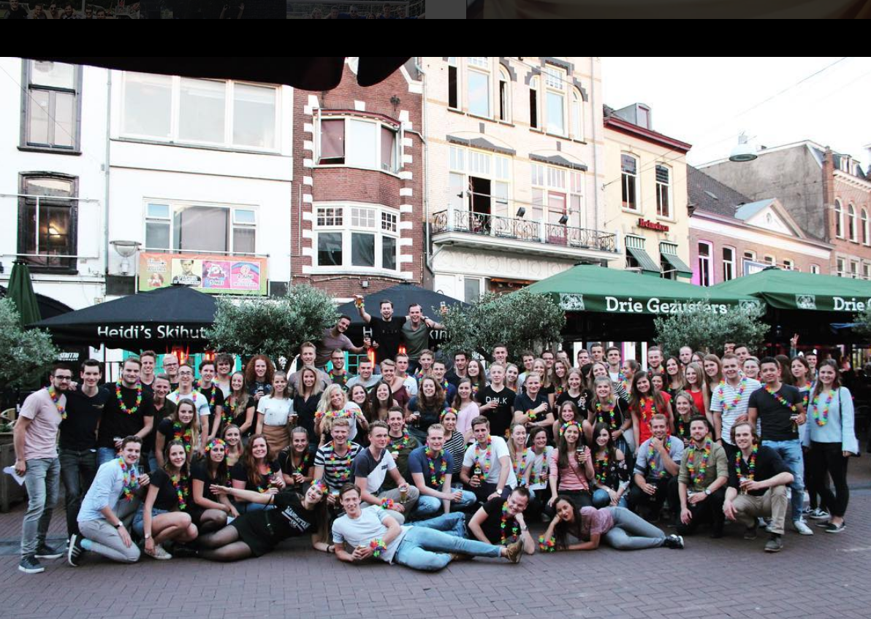
Active Membership Activity

Slide 30
Commitee Training
Helps you prepare for your role in the committee
Involves organizing, planning, teambuilding and professionalism

Slide 31
Deadline
You can register for a committee from today 15:00h till the 22th of September, 15:00h via the website:
www.synergy.nu/activemembership
You can give up 3 preferences!
If you want to be a chairman of a committee, check that box and send a motivation letter to secretary@synergy.nu

